Slide 1
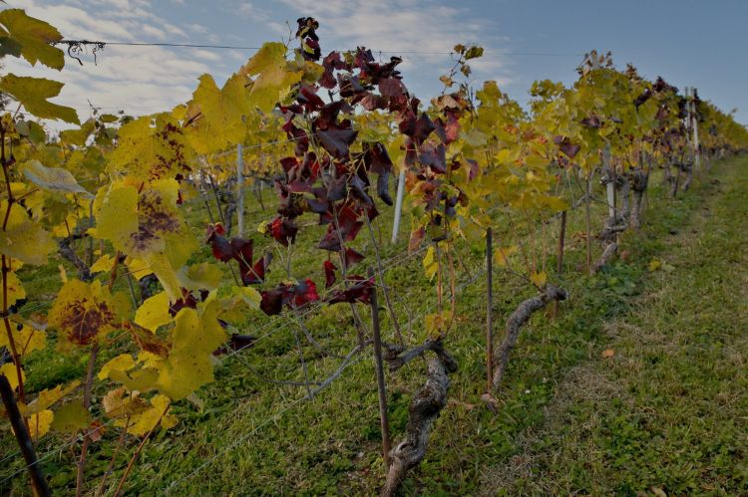
Flavescence Dorée
Inform on FD
This project has received funding from the European Union's Horizon 2020 research and innovation programme under grant agreement N°652601

Slide 2
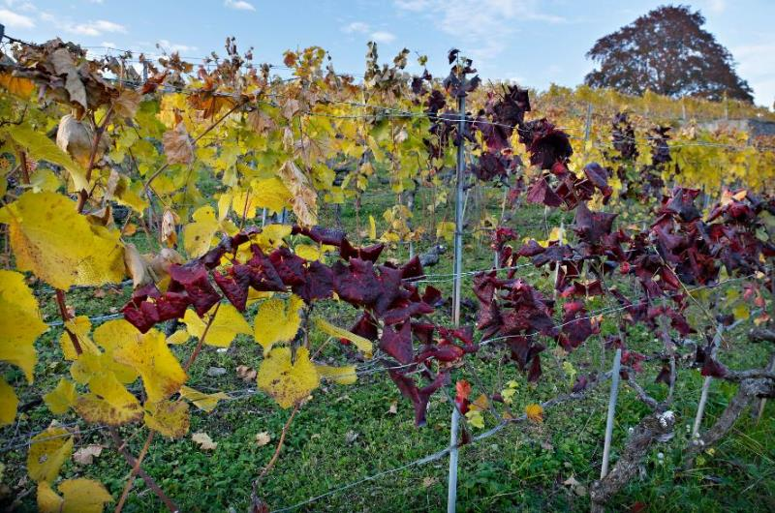
Flavescence Dorée
What is it?
Flavescence dorèe is a disease widely spread caused by a phytoplasma.

Slide 3
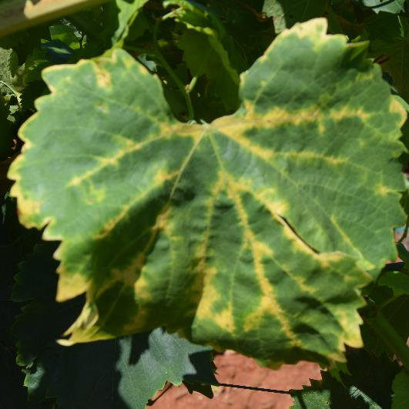
Flavescence Dorée
What is it?
A phytoplasma is a microorganism that lives inside of the plant, usually it does not kill the vine but it does obstruct the lymph path and alters the plant metabolism.

Slide 4
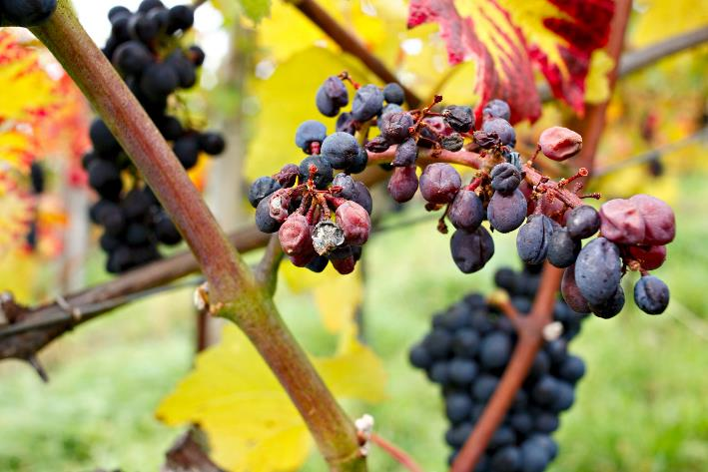
Flavescence Dorée
What is it?
FD could cause huge production losses, for this reason it is considered a serious quarantine disease by the European phytosanitary regulations.

Slide 5
Flavescence Dorée
What is it?
The economic consequences of this disease are enormous and once a plant gets infected it can never heal.

Slide 6
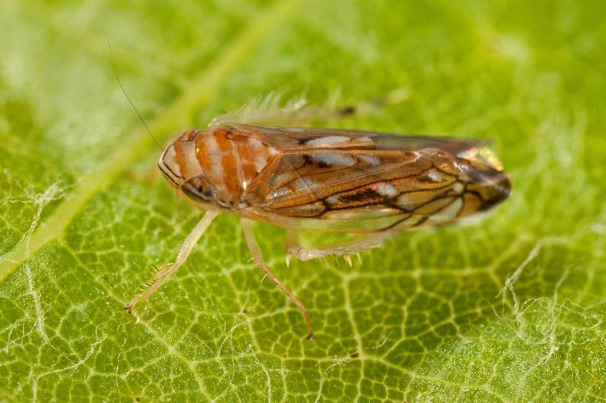
Flavescence Dorée
What is it?
The FD phytoplasma is transmitted plant to plant by an insect, schapoideus titanus that feeds on the vine’s lymph.

Slide 7
Flavescence Dorée
Disease spreading
The FD is a European endemic disease, it became of economic interest only in 1955 when schapoideus titanus came to Europe from the North American regions and begun to spread the FD phytoplasma.

Slide 8
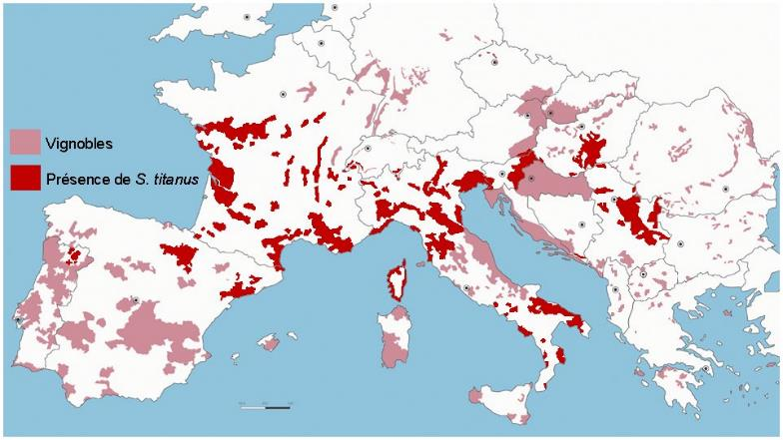
Flavescence Dorée
Disease spreading
Now the disease is mostly spread in Italy, France and Croatia.
The disease is also present in smaller quantity in Portugal, Spain, Hungary and Germany.

Slide 9
Flavescence Dorée
Disease spreading
Flavescence Dorée could only be transmitted by a vector insect, and it causes economic problem only when both the phytoplasma and the insect are present in the vineyard.
For this reason in the following slides we will discuss on the insect monitoring.

Slide 10
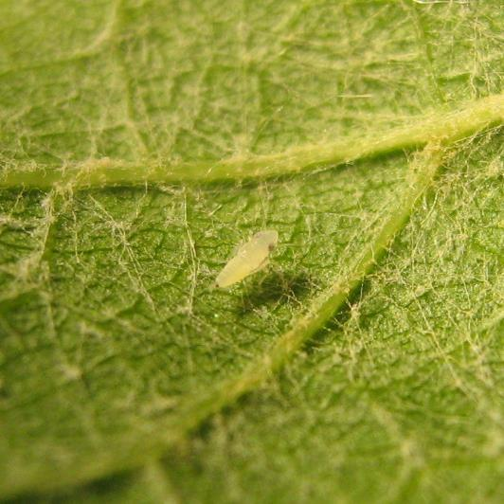
Flavescence Dorée
Scaphoideus titanus
The scientific name of the vector insect is Scaphoideus titanus, it is a small leafhopper, 5 mm long, that feeds on the vine lymph.

Slide 11
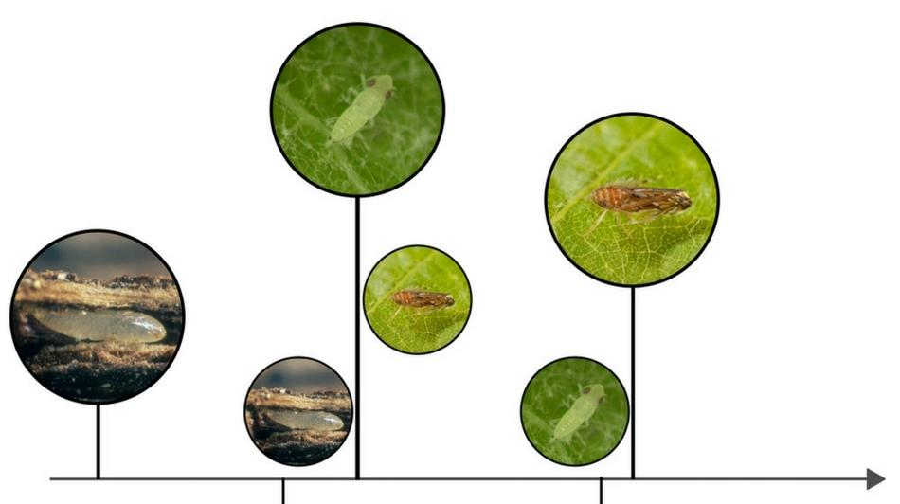
Flavescence Dorée
Scaphoideus titanus
ST Lifecycle is entirely on the vine; it lives, eats and reproduces on the lower part of the leaf.
Spring
Summer

Slide 12
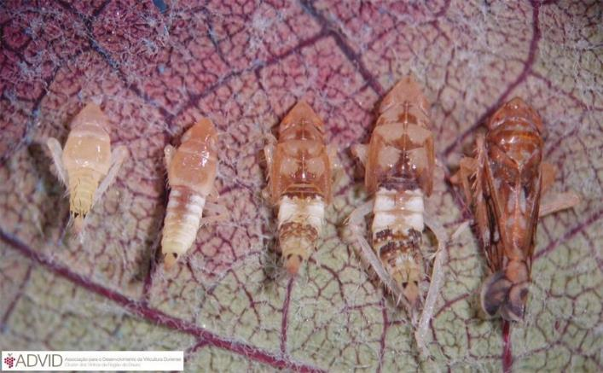
Flavescence Dorée
Scaphoideus titanus
ST has just one generation per year, it overwinters as an egg below the bark, and then in the middle of the spring it hatches; after five juvenile forms it becomes an adult, which is the only form able to fly.

Slide 13
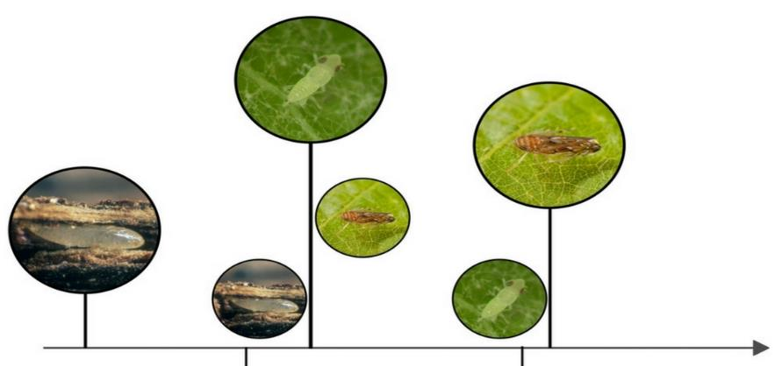
Flavescence Dorée
Scaphoideus titanus
The eggs do not hatch at the same time, so in the same vineyard you can sometimes find both adults and juvenile forms, and so you have to be careful on the insecticide treatment timing.
Spring
Summer

Slide 14
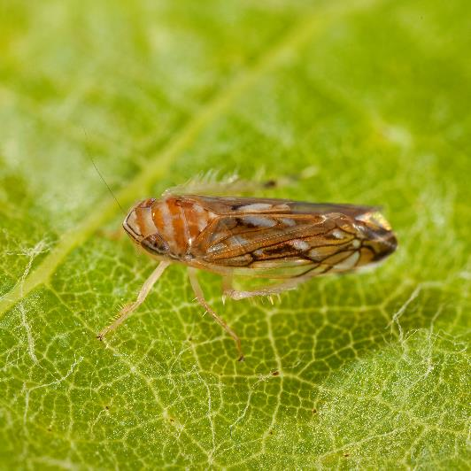
Flavescence Dorée
Scaphoideus titanus
Adults are the most responsible for the disease spreading, because, since they can fly, they are the form that moves the most in the vineyard.

Slide 15
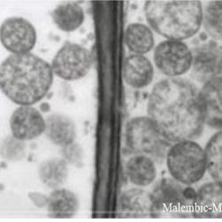
Flavescence Dorée
Phytoplasma lifecycle
FD phytoplasma is a cell wall-less bacteria that lives inside the phloem of the vine. If ST feeds on an infected vine, it gets infected as well.

Slide 16
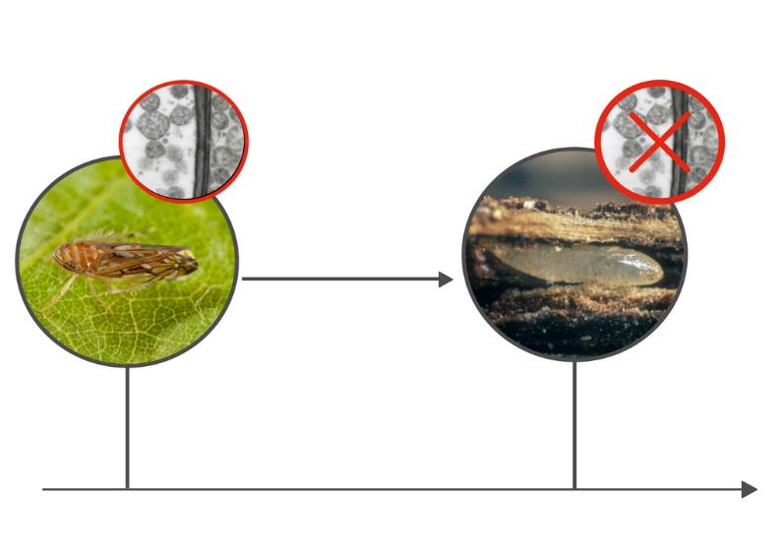
Flavescence Dorée
Phytoplasma lifecycle
Once ST is infected, after a latency period of 30 DAYS, it will remain contagious until the end of its life; luckily the disease is not passed down to the next generations, so each time an egg hatches the new leafhopper is not contagious.
Next generation

Slide 17
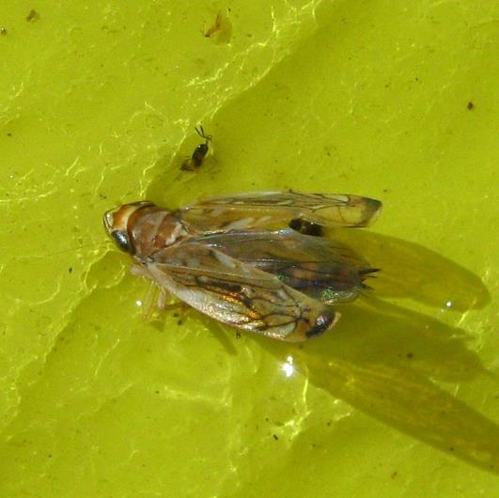
Flavescence Dorée
Monitoring St
Monitoring Scaphoideus titanus means estimating the number of insects in the vineyard, this is done using a chromatic plate.
Those plates will attract the insects that will remain stuck, with the number of insect on the trap is possible to estimate the population in the field.
Notes:
The best idea would be to have a plate physically to show to the class

Slide 18
Flavescence Dorée
Monitoring St
The monitoring of ST is done in order to understand:
When the adult appears in the vineyard
When is the best time to treat
Study the population of the insect in different years.

Slide 19
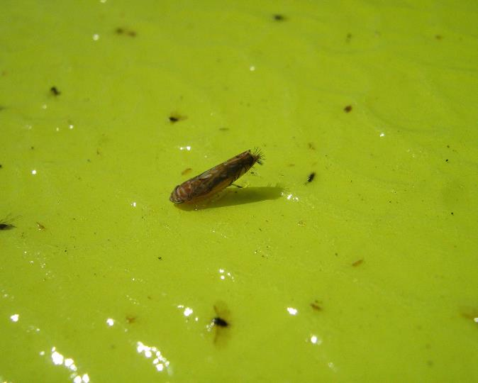
Flavescence Dorée
How to Monitor St
In order to monitor ST we use a chromatic plate, this because the yellow color attracts the insects. This plate is adhesive, so the insect that lay on it are going to be stuck.

Slide 20
Flavescence Dorée
How to Monitor St
It is possible to put in place this chromatic trap since the larval stadium L4 or L5 is observed, in order to forecast the appearing of the adult.

Slide 21
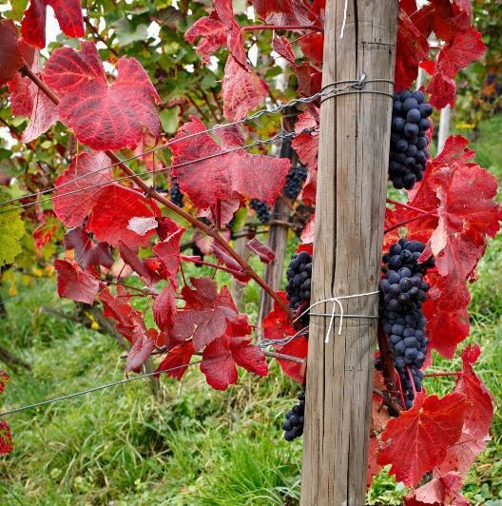
Flavescence Dorée
How to Monitor St
It is advisable to place the trap in the vineyards that historically show the presence of the insect in order to observe the quantity of the adults and when this reaches the peak.

Slide 22
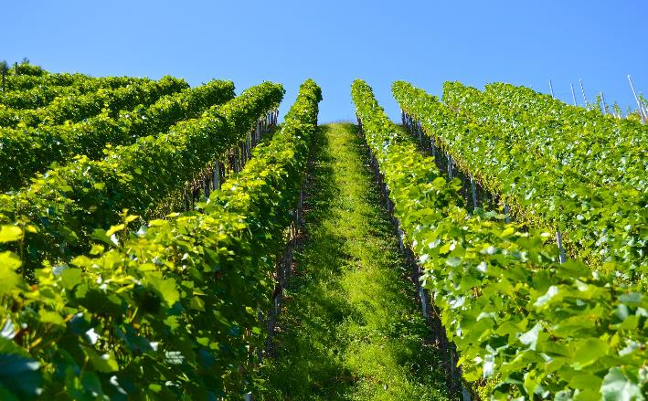
Flavescence Dorée
How to Monitor St
It is also possible to use the plate on asymptomatic vineyards in order to understand if Flavescence Dorèe could be a problem in the future.

Slide 23
Flavescence Dorée
How to Monitor St
In order to make things easier is possible to fix the trap on the vineyard wire.
So the best way to place the trap is to put it as close as possible to the leaves, because the adults are there.
Once the trap is placed it is possible to come and monitor it once every one or two weeks.

Slide 24
Flavescence Dorée
Quiz
Please answer to the given questions
Notes:
(15 minutes)

Slide 25
Flavescence Dorée
Video-clip

Slide 26
Flavescence Dorée
Quiz
Results and Discussion

Slide 27
Flavescence Dorée
Symptoms
Flavescence Dorée presents several symptoms that are going to be shown in the following slides.
The symptoms could easily be confused with other diseases, so only if all the symptoms are present on the vine is possible to diagnose the disease.

Slide 28
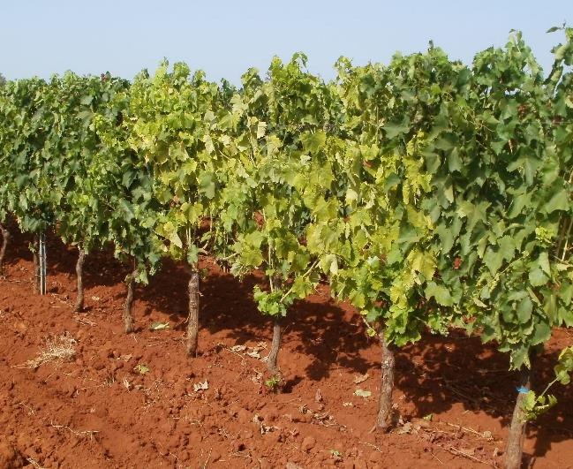
Flavescence Dorée
Symptoms
The disease is called Flavescence Dorée because the leaves of the infected plant turn yellow (for the white grapes variety), and red for the red ones.

Slide 29
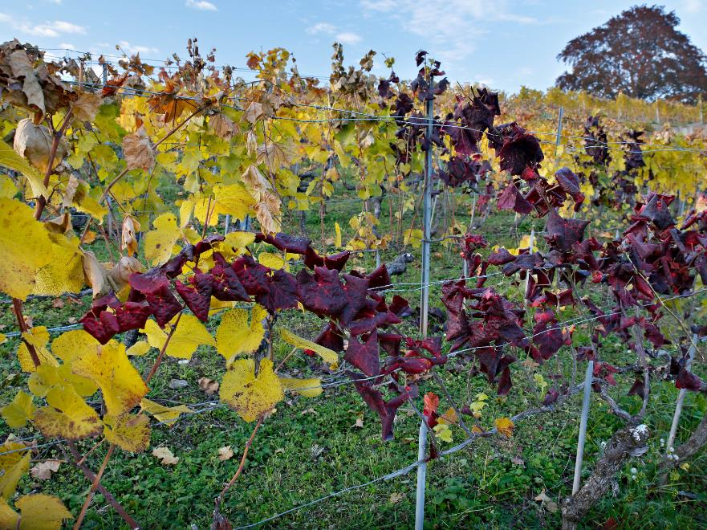
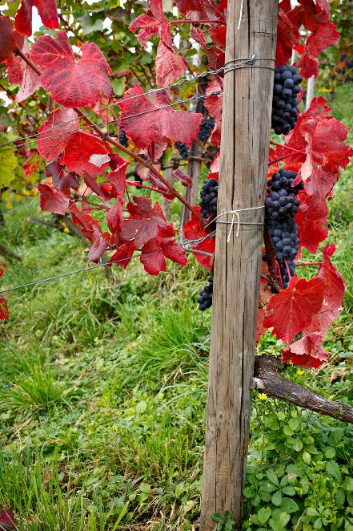
Flavescence Dorée
Symptoms

Slide 30
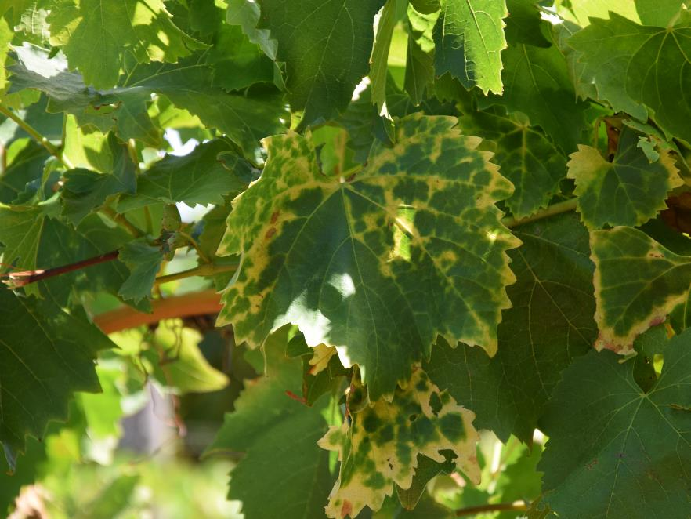
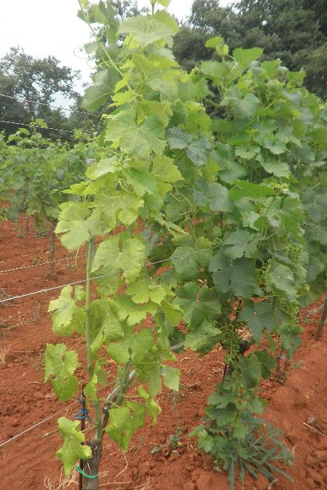
Flavescence Dorée
Symptoms

Slide 31
Flavescence Dorée
Symptoms
After being stung by an infected leafhopper the leaf starts to turn yellow; the first part that changes color are the leaf veins.

Slide 32
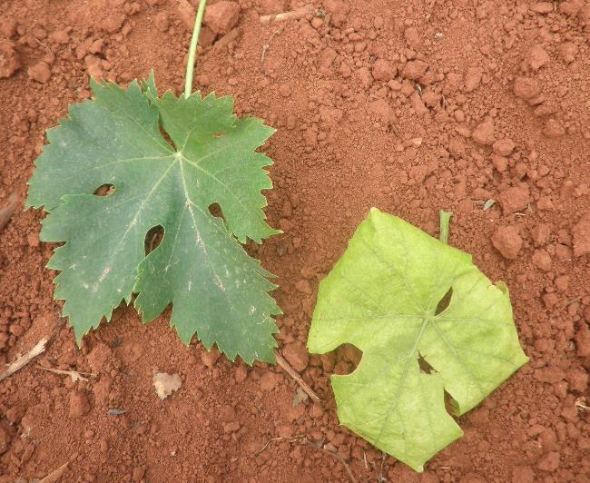
Flavescence Dorée
Symptoms
The leaves of the infected plants do not only turn yellow, but they also get bent downwards.

Slide 33
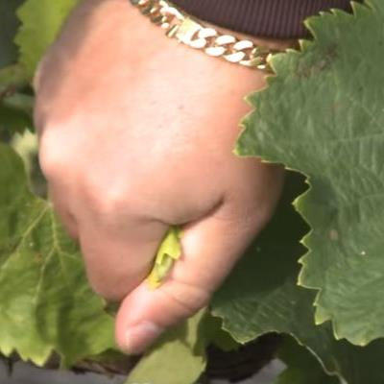
Flavescence Dorée
Symptoms
Another symptom that affects the leaves is the crunchiness, as soon as you squeeze a leaf in your hand you will notice its crunchiness.

Slide 34
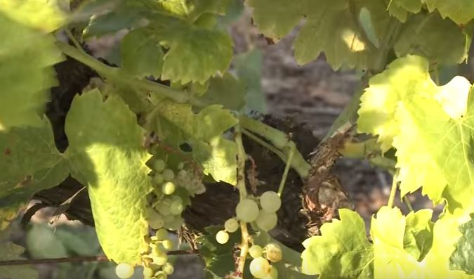
Flavescence Dorée
Symptoms
A symptom that is fundamental in diagnosing the disease is that the brunches do not lignify.

Slide 35
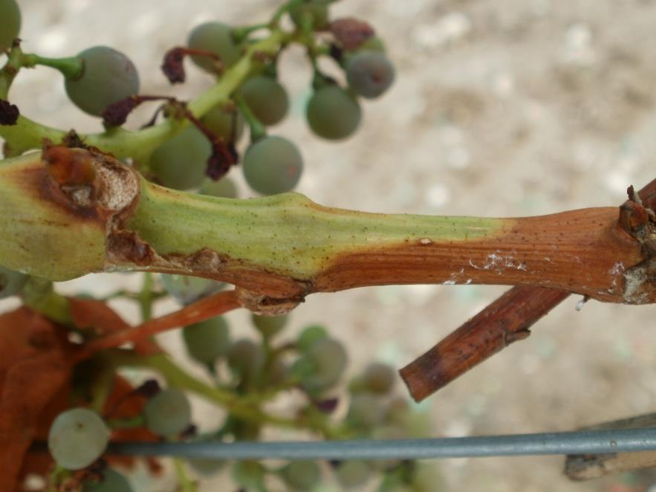
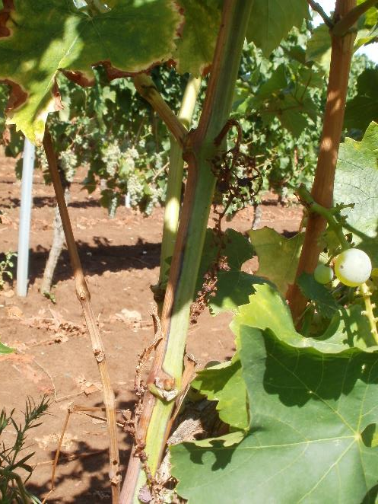
Flavescence Dorée
Symptoms

Slide 36
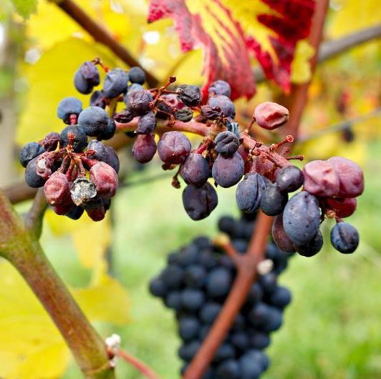
Flavescence Dorée
Symptoms
Concerning the grapes the cluster are smaller, and some grapes are dried out. Some of the clusters are completely dried out.

Slide 37
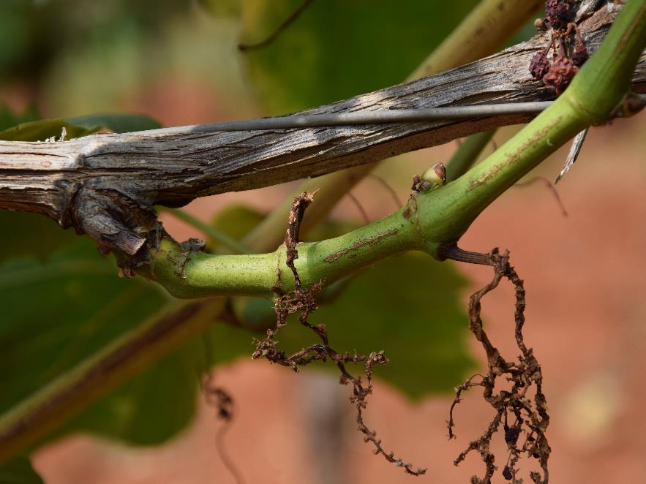
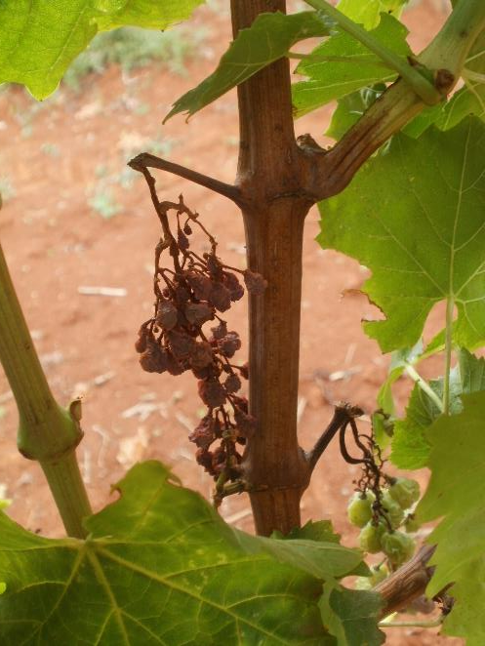
Flavescence Dorée
Symptoms

Slide 38
Flavescence Dorée
False symptoms
FD symptoms, especially the ones on the leaves, could be easily mistaken with:
Empoasca vitis bites
Cold spring symptoms
Herbicide
Esca disease
Nutritional deficits

Slide 39
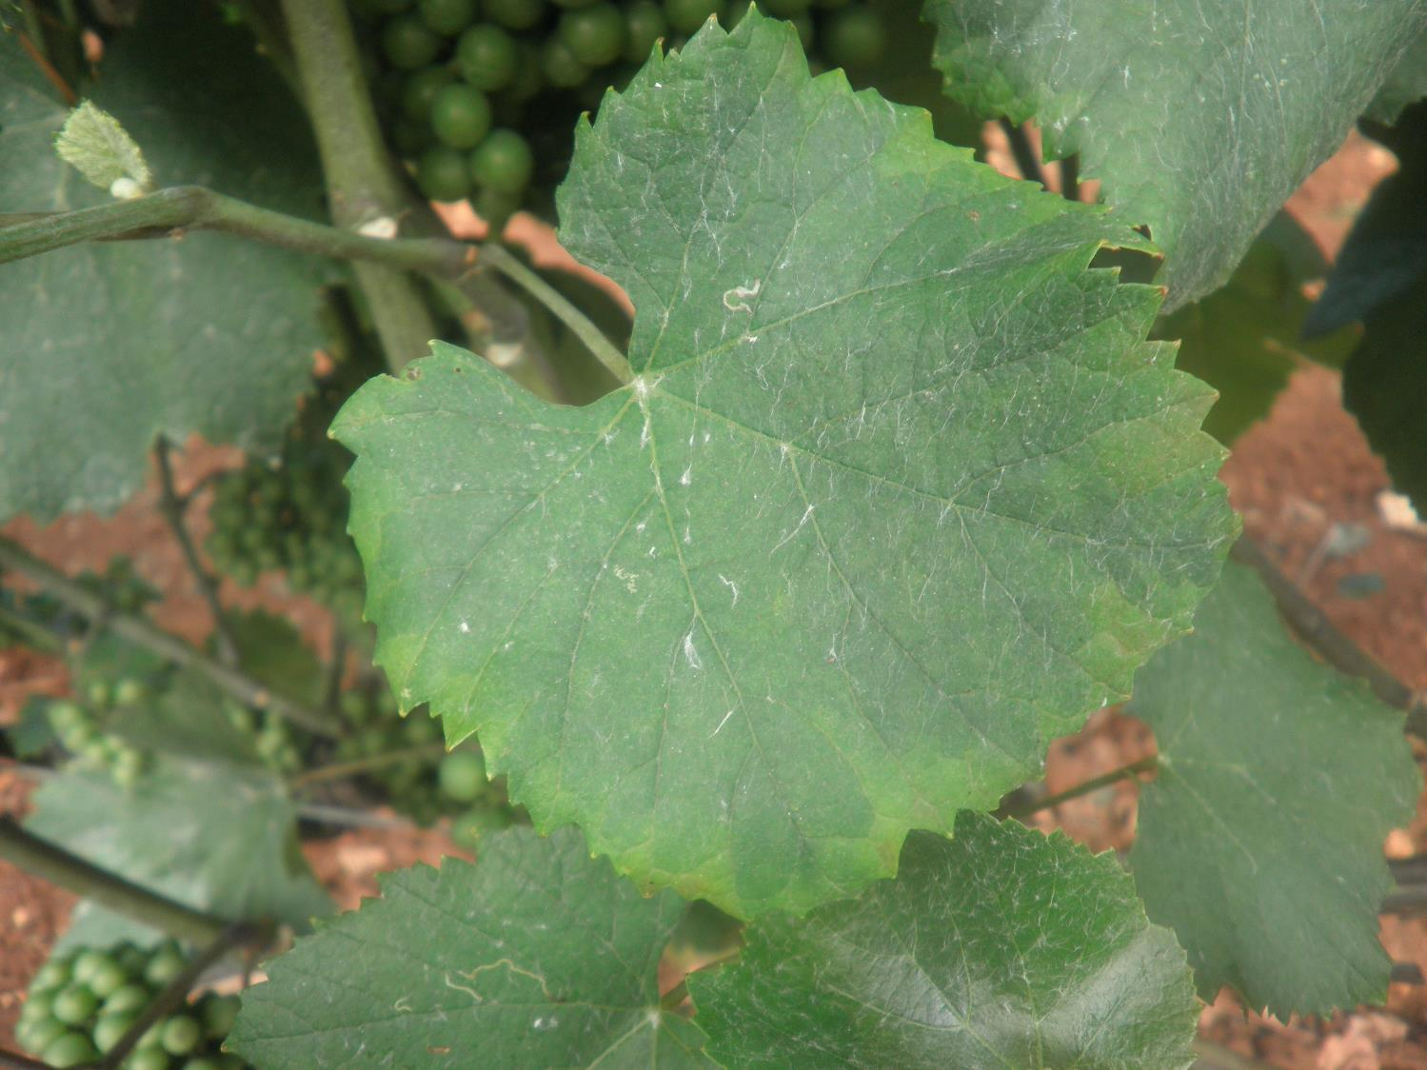
Flavescence Dorée
Empoasca vitis bites

Slide 40
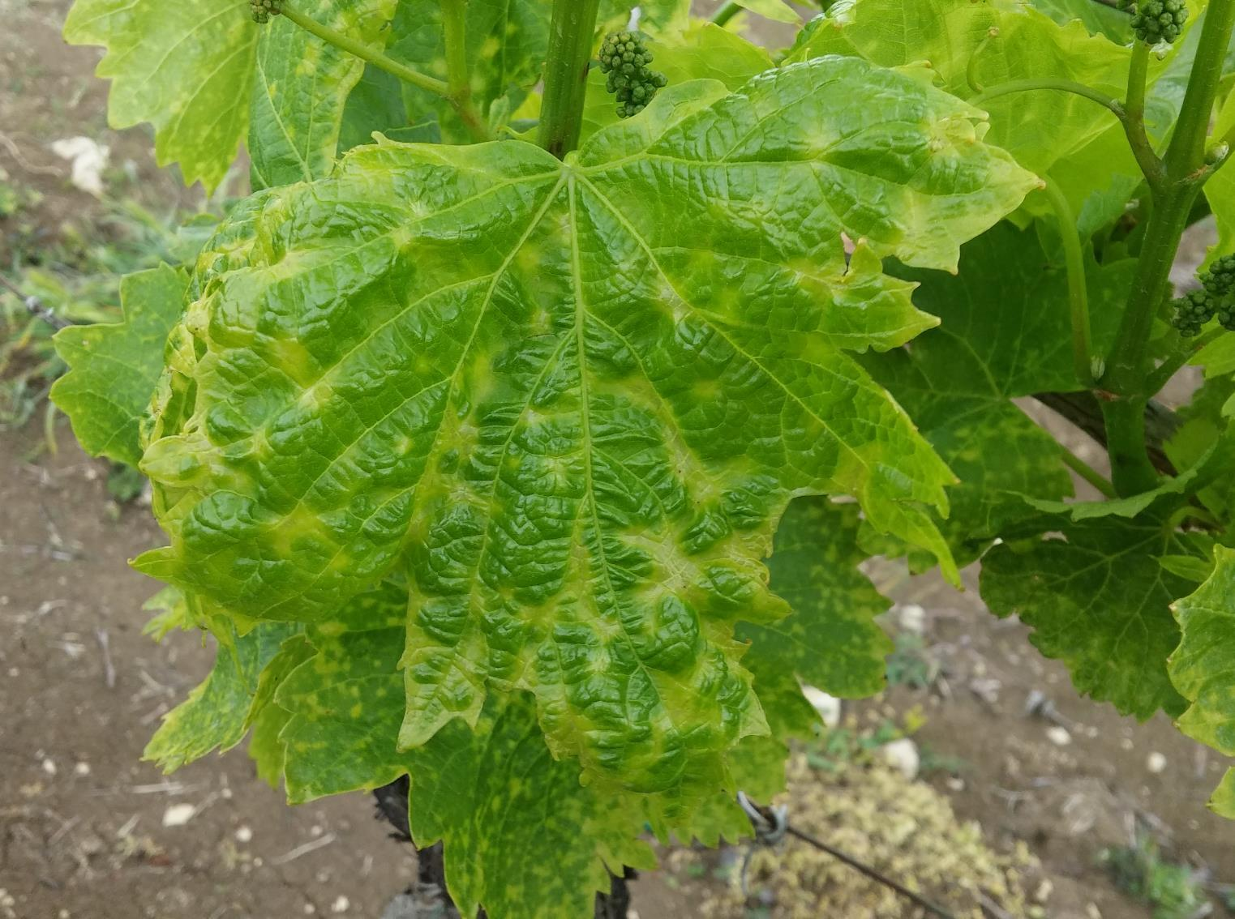
Flavescence Dorée
Cold spring symptoms

Slide 41
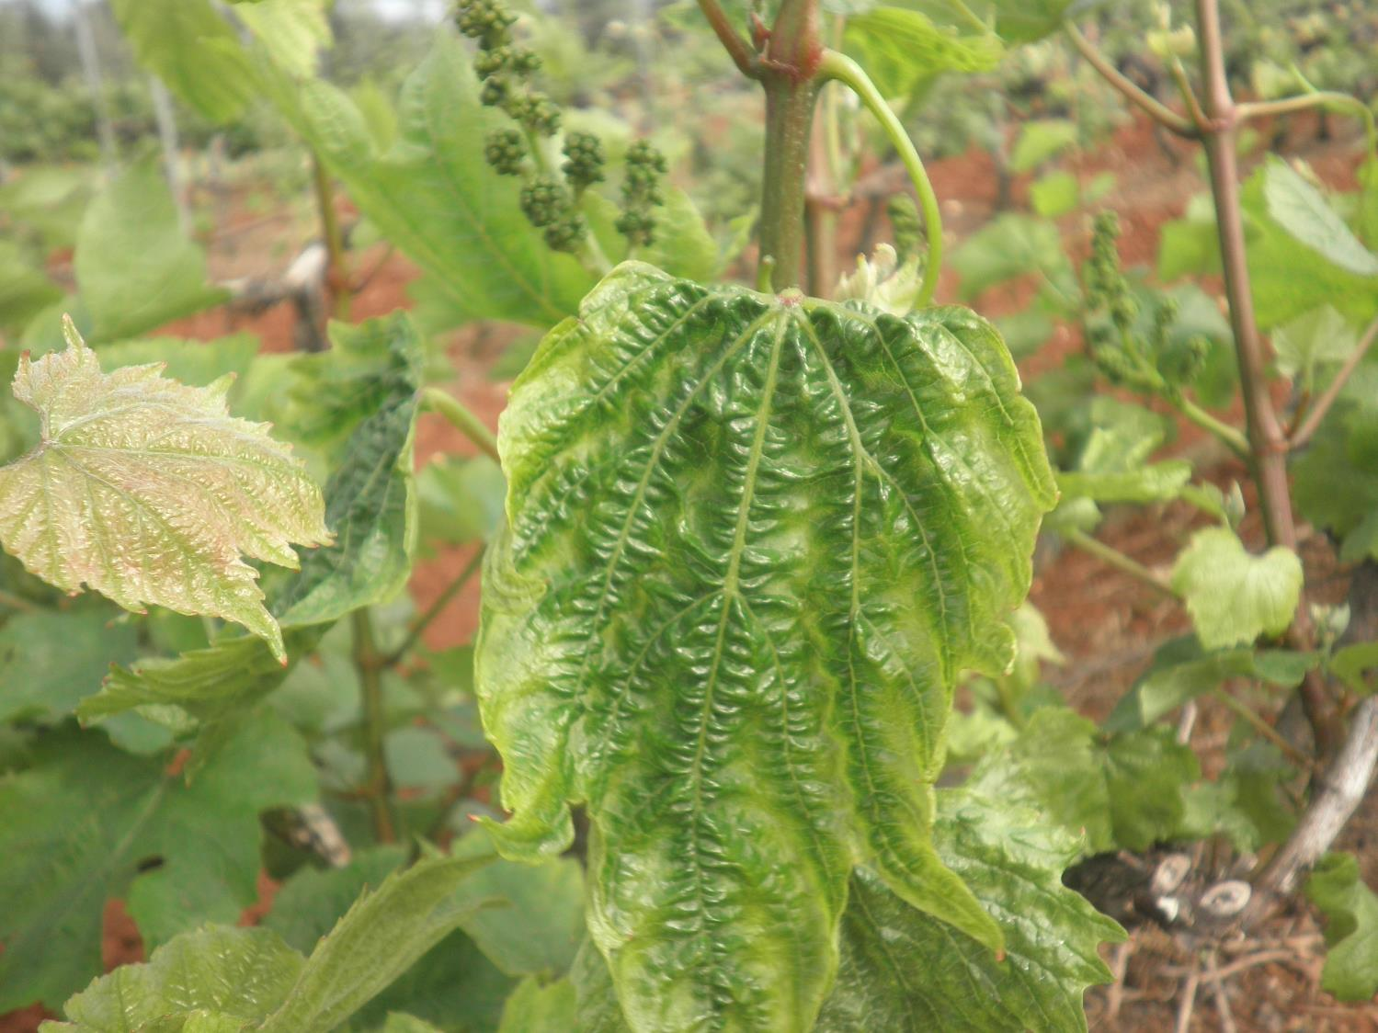
Flavescence Dorée
Herbicide

Slide 42
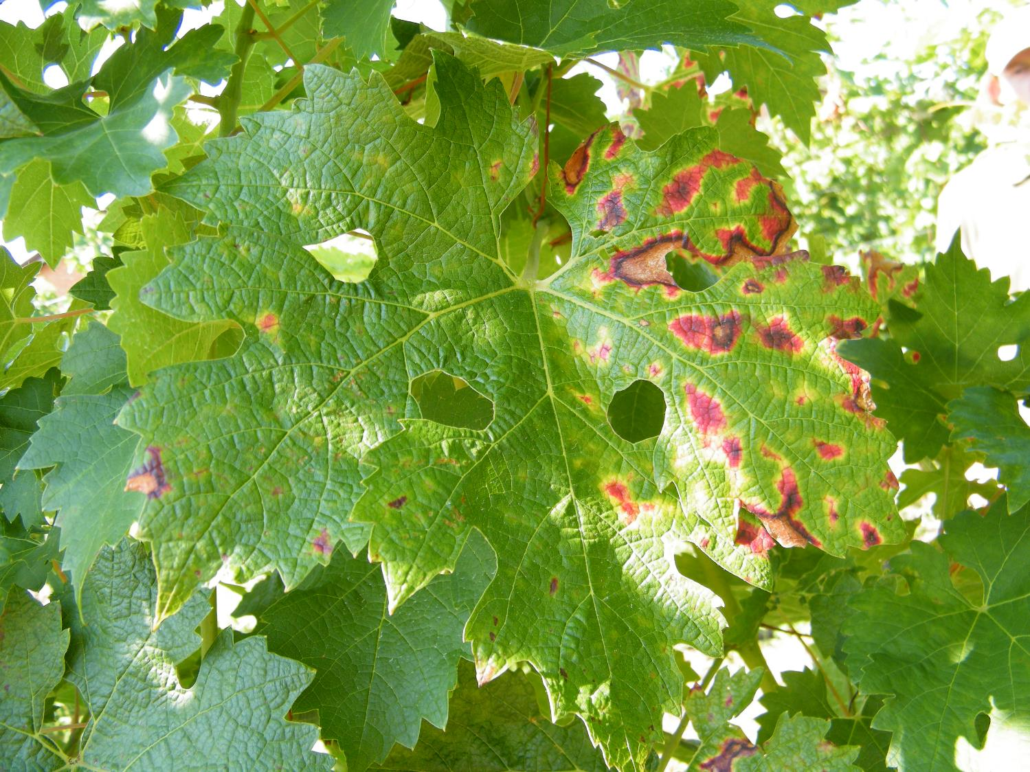
Flavescence Dorée
Esca disease

Slide 43
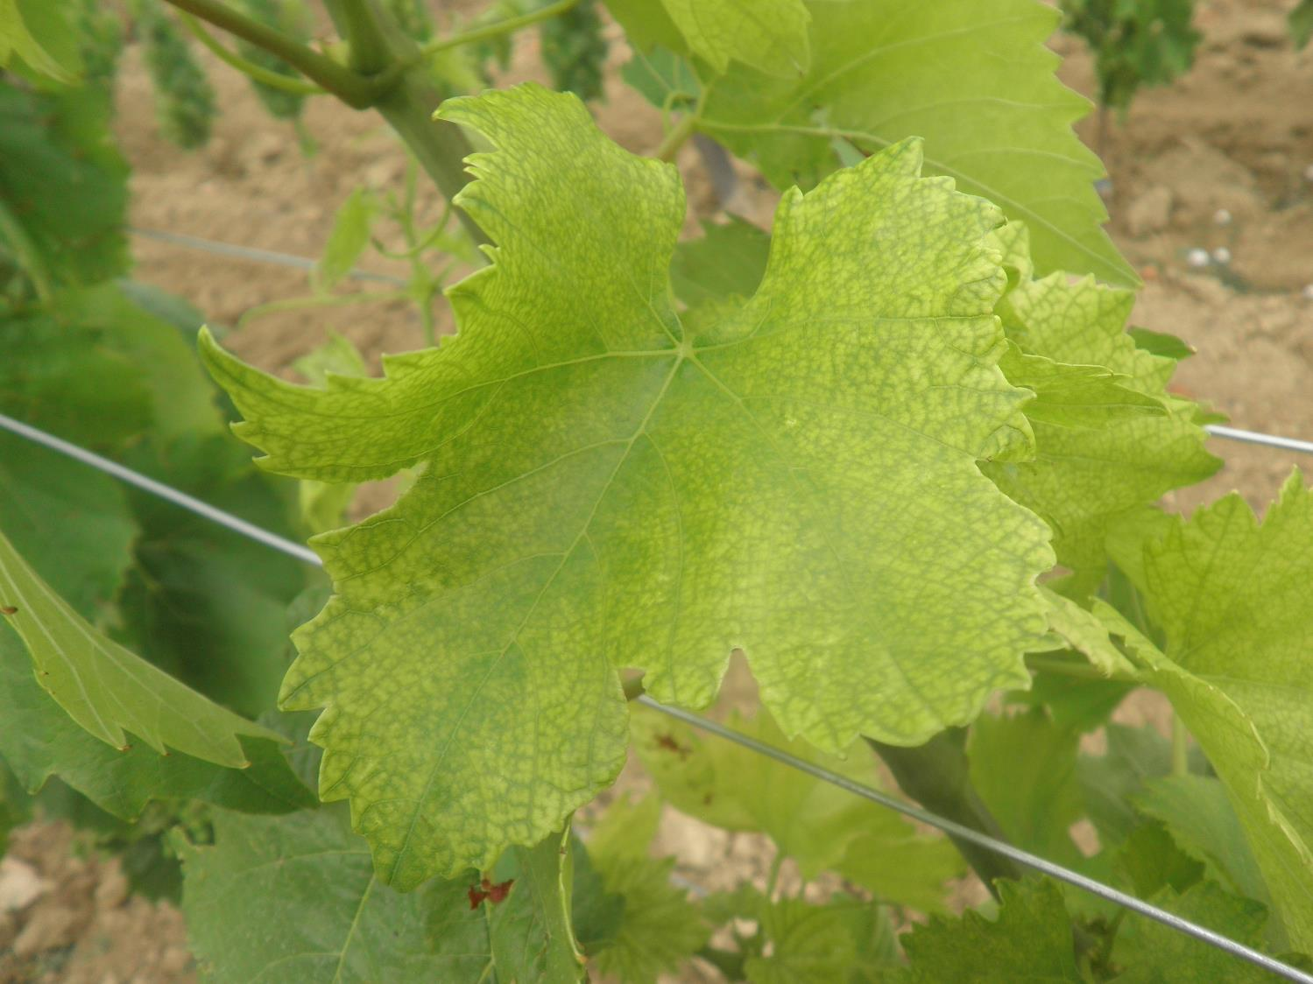
Flavescence Dorée
Nutritional deficit

Slide 44
Flavescence Dorée
Bois Noir
FD show symptoms equal to the Bois Noir disease, in the field is not possible to distinguish between the two, only with proper laboratory analysis it is possible to know if it is FD or bois noir.

Slide 45
Flavescence Dorée
Quiz
Please answer to the given questions
Notes:
(15 minutes)

Slide 46
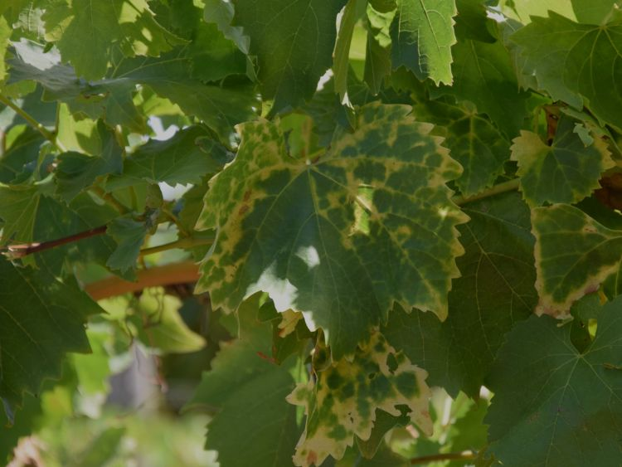
Flavescence Dorée
Quiz 1
Notes:
FD

Slide 47
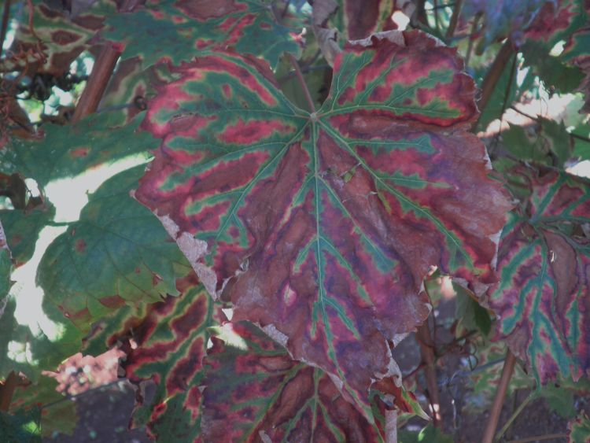
Flavescence Dorée
Quiz 2
Notes:
esca

Slide 48
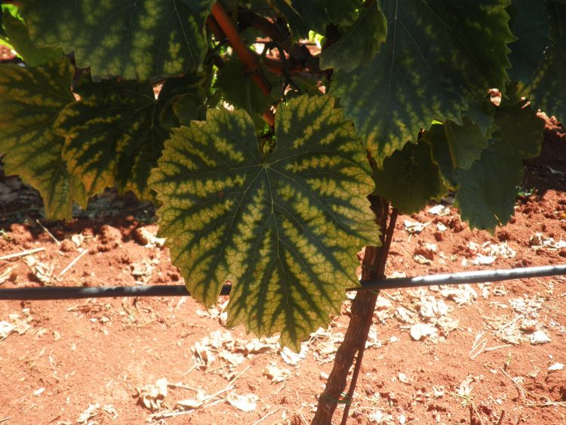
Flavescence Dorée
Quiz 3
Notes:
Mg deficit

Slide 49
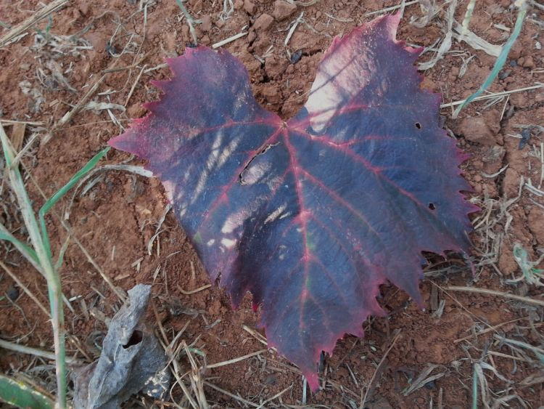
Flavescence Dorée
Quiz 4
Notes:
FD

Slide 50
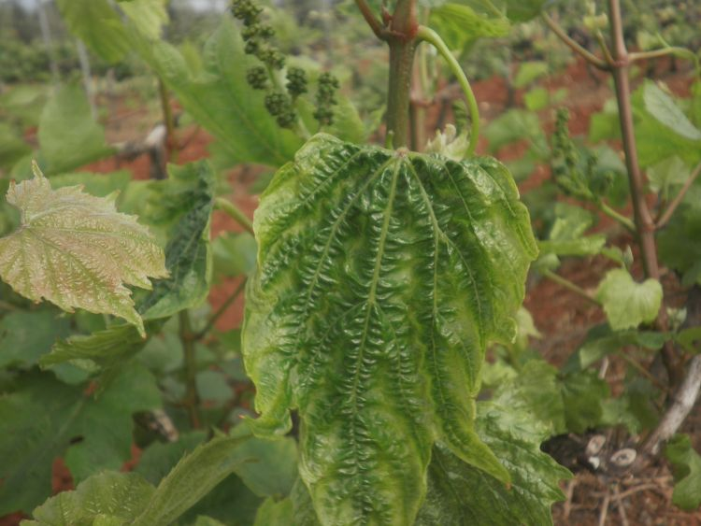
Flavescence Dorée
Quiz 5
Notes:
herbicide

Slide 51
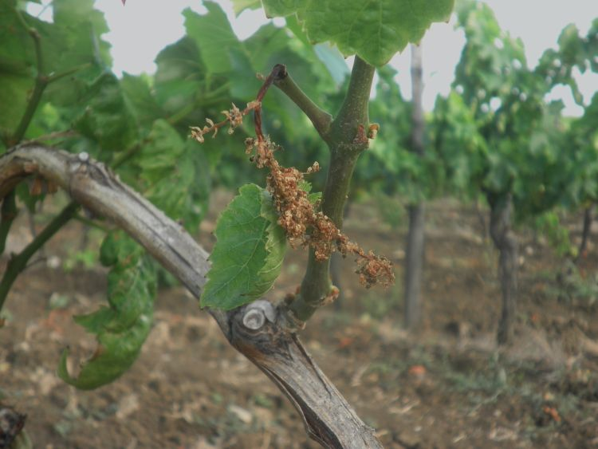
Flavescence Dorée
Quiz 6
Notes:
FD

Slide 52
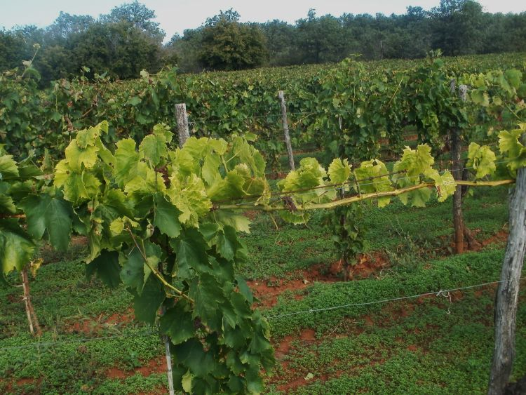
Flavescence Dorée
Quiz 7
Notes:
fd

Slide 53
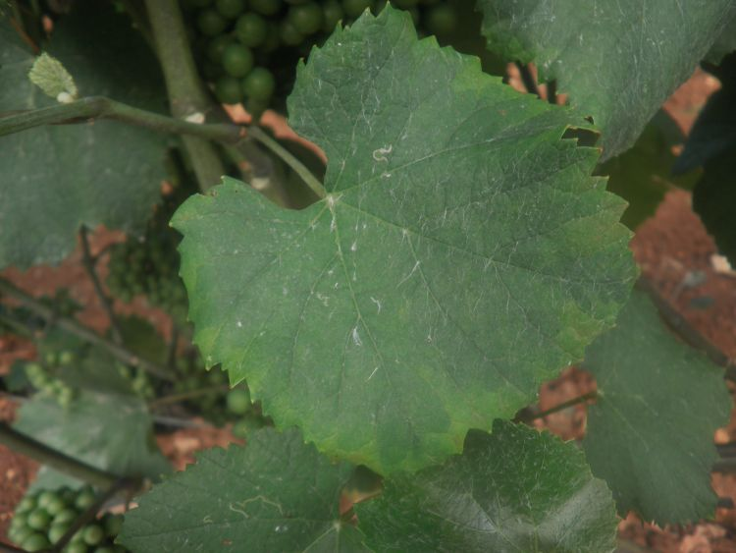
Flavescence Dorée
Quiz 8
Notes:
empoasca

Slide 54
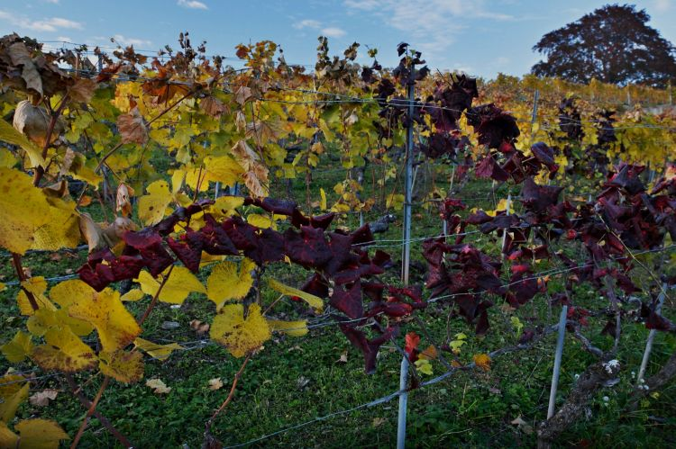
Flavescence Dorée
Quiz 9
Notes:
fd

Slide 55
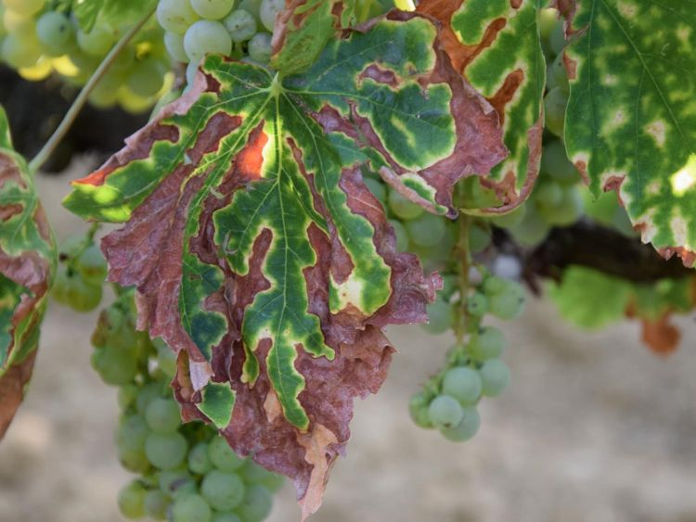
Flavescence Dorée
Quiz 10
Notes:
esca

Slide 56
Flavescence Dorée
Video-clip

Slide 57
Flavescence Dorée
Quiz
Results and Discussion

