Slide 1

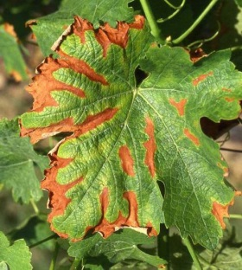
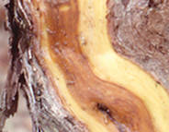
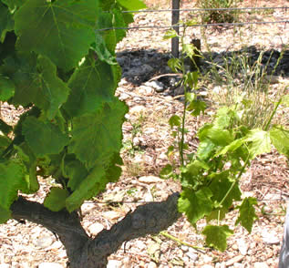
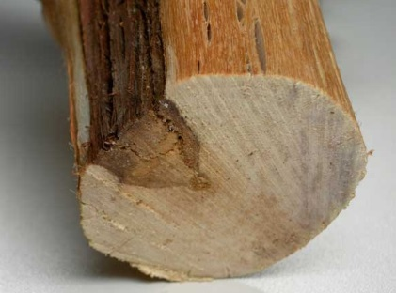
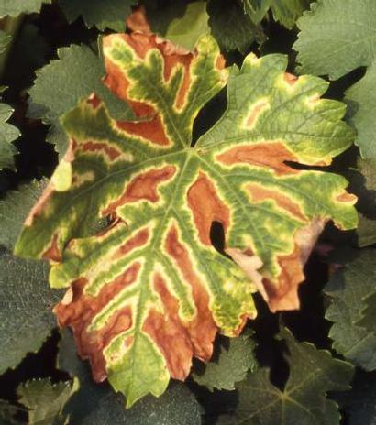
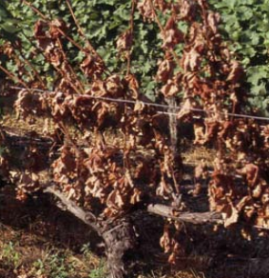

Grapevine Trunk Diseases
Global vineyard strategy to prevent GTDs
This project has received funding from the European Union’s Horizon 2020 research and innovation programme under grant agreement No 652601

Slide 2

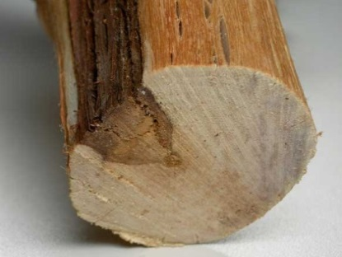
Introduction
Grapevine trunk diseases
Complex of pathogenic fungi
Increase for different causes as the prohibition of chemicals (sodium arsenite, benomyl, carbendazim)
No efficient and simple treatments
→ Prophylactic strategies to use both
in nursery and in the vineyard
Notes:
Grapevine trunk diseases (GTDs), caused by a complex of pathogenic fungi, have increased especially following the prohibition of chemical products as sodium arsenite (for Esca) first and the Benzimidazoles Benomyl and carbendazim, later.
Their eradication is not simple: currently, no efficient treatment exists.
For this reason and in order to avoid GTDs spread, prophylactic methods should be used and implemented both in nursery and vineyard, since its planting

Slide 3
Main symptoms caused by GTDs fungi
Affection of the perennial organs → lead to death
Chronic or apoplectic form
Foliar symptoms : necrosis / discoloration / stunting
Inflorescences & fruits : dry out / black points (black measles)
Wood: degradation of woody tissues with necrosis and white rot
→ Esca, Botryosphaeria dieback and Eutypa dieback
Notes:
GTDs, caused by a complex of pathogenic fungi, affect the perennial organs of the vine, causing their death in the long term.
Two forms, a chronic and a severe called apoplectic, are found in the vineyard.
The chronic form causes vigor loss and leads to the death of a part of vine and then to its totality. Foliar symptoms are characterized by necrotic areas (staining or tabby appearance) or stunting. The inflorescences and fruits may dry out or take on a pumpkins and peas appearance. GTDs cause necrosis and degradation in the wood by blocking the vessels or forming cankers.
This article focuses primarily on the following three trunk diseases: Esca, Botryosphaeria dieback and Eutypa dieback.

Slide 4
Symptoms and causal agents of Esca
Various pathogenic fungi (e.g P. chlamydospora, P. aleophilum, Fomitipora spp.)
Chronic or apoplectic form
Symptoms on leaves (Tiger-strips leaves)
Symptoms on wood
Symptoms on fruits
Purplish spots on berries / black measles
White and soft rot in central position (which gradually changes the hard wood to a soft, friable, spongy mass.)
Light green or chlorotic leaves
Premature leaf fall
Cross section are often bordered by a thick black or dark brown line separating rotted from non decayed wood.
Chlorotic tissue turns yellow-brown or red-brown
Delay of ripening or desiccation of berries
Rounded or irregular spots between the veins or along the leaf margins
Notes:
Esca is a complex disease caused by a various pathogenic fungi such as Phaeomoniella chlamydospora and Phaeoacremonium aleophilum.
Fomitiporia mediterranea is responsible for “amadou”.
This disease has an apoplectic form and a chronic form.
The rapid form is characterized by rapid drying of a part or the entire vine.
The chronic form is characterized by an inter-nervous staining, yellow on white grape varieties and red on black grape varieties with a yellow border. Foliar necrosis then evolves towards a leaves drying. Two types of necrosis can be observed in the wood. A central necrosis with a clear, tender zone in the center surrounded by a black border and a sectorial necrosis with a clear and tender zone surrounded by a hard brown/black zone are characteristic of Esca. Fruits may dry out resulting in crop losses.

Slide 5
Symptoms and causal agents of Eutypa dieback
Eutypa lata
Symptoms on vegetation
Symptoms on wood
Symptoms on fruits
Millerandage
Chlorotic or deformed leaves (cup-shaped)
Shorterned internodes
Stunted branches
Sagging
Brown and hard sectorial necrosis
Notes:
Esca is a complex disease caused by a various pathogenic fungi such as Phaeomoniella chlamydospora and Phaeoacremonium aleophilum.
Fomitiporia mediterranea is responsible for “amadou”.
This disease has an apoplectic form and a chronic form.
The rapid form is characterized by rapid drying of a part or the entire vine.
The chronic form is characterized by an inter-nervous staining, yellow on white grape varieties and red on black grape varieties with a yellow border. Foliar necrosis then evolves towards a leaves drying. Two types of necrosis can be observed in the wood. A central necrosis with a clear, tender zone in the center surrounded by a black border and a sectorial necrosis with a clear and tender zone surrounded by a hard brown/black zone are characteristic of Esca. Fruits may dry out resulting in crop losses.

Slide 6
Symptoms and causal agents of botryosphaeria dieback
, Diplodia spp, Neofusicoccum spp, Lasiodiplodia spp,
Symptoms similar to esca
Chronic or apoplectic form
Symptoms on leaves
Symptoms on wood
Symptoms on fruits
Staining
After removing the bark : brown band surrounded by a yellow/orange zone or a brown/black sectorial necrosis
Rapid desiccation and destruction of the inflorescences and fruits
Necrosis
Stunted cane development in spring
Notes:
Esca is a complex disease caused by a various pathogenic fungi such as Phaeomoniella chlamydospora and Phaeoacremonium aleophilum.
Fomitiporia mediterranea is responsible for “amadou”.
This disease has an apoplectic form and a chronic form.
The rapid form is characterized by rapid drying of a part or the entire vine.
The chronic form is characterized by an inter-nervous staining, yellow on white grape varieties and red on black grape varieties with a yellow border. Foliar necrosis then evolves towards a leaves drying. Two types of necrosis can be observed in the wood. A central necrosis with a clear, tender zone in the center surrounded by a black border and a sectorial necrosis with a clear and tender zone surrounded by a hard brown/black zone are characteristic of Esca. Fruits may dry out resulting in crop losses.

Slide 7
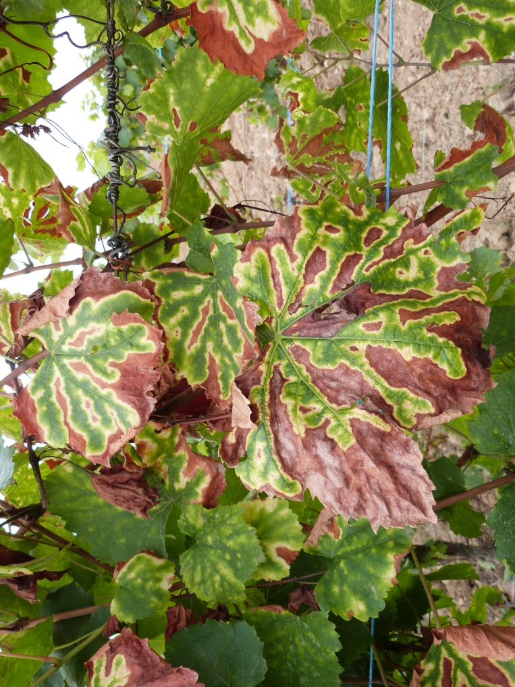
Factors influencing GTDs symptoms
Biotic or abiotic factors
Climatic conditions → role in the pathogen species and development
Dry periods = water stress → favorable to pathogens development
Other microorganisms or GTDs agents could interfere with pathogen
Foliar symptoms differ from year to year (especially for Esca)

Slide 8
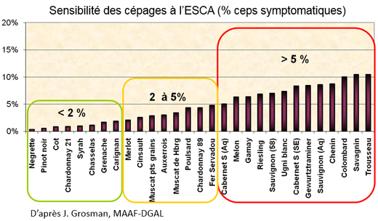
Factors influencing GTDs symptoms
Vineyard age and cultivar, training and pruning system
Prevalence of Esca/BDA = 12/18 years and then decreases until 40 years
Prevalence of eutypiosis = 25/40 years

Slide 9
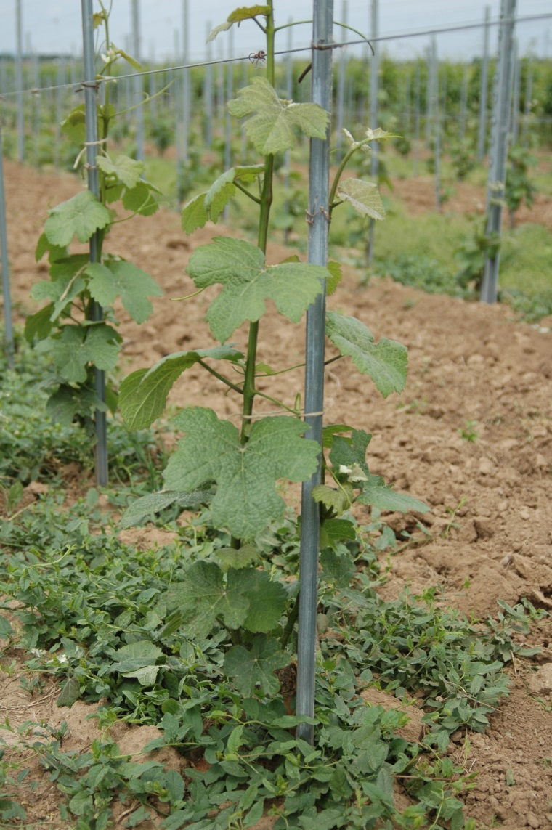
Preventive methods during planting
Quality of grafted plants
Hot Water Treatment, chemical or biological methods during the plant production process when available
Sensitivity of grapes varieties or rootstocks
Planting conditions
Watering to avoid water stress
Vine formation system

Slide 10
Soil management
Soil = main source of inoculum
Avoid :
  plant stress
  unbalanced supply of nutrients
  unreasonable nitrogen fertilization
  bad drainage
  soil compaction
To do :
  establishment of permanent or non-permanent vegetation cover crop

Slide 11
Pruning system
Pruning wounds = main entry point for pathogens
Prune during dry periods
Late pruning = better heal
Wound susceptibility influenced by the relative humidity and rainfall
No efficient contamination trough pruning scissors

Slide 12
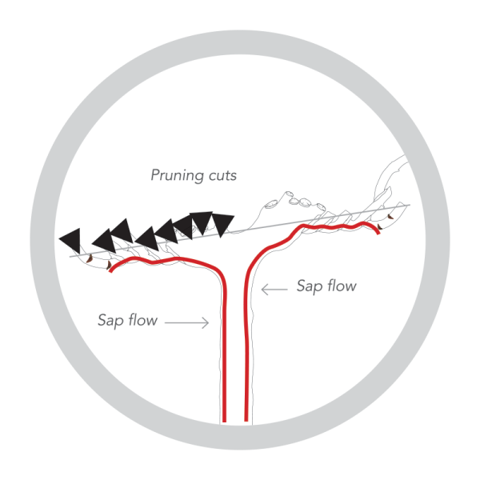
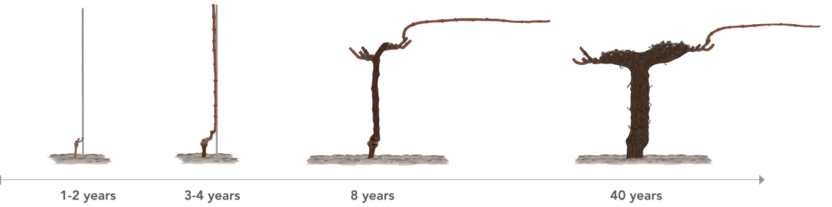
Pruning system
Pruning wounds correlated with underlying necrosis → deteriorate the sap flux
Residual length of the pruned spur : at least 1.5 times its diameter
Guyot-Poussard pruning method = preservation of sap flux
Protect pruning wounds preventively using fungicides , bio-control products or mastics
Applied locally as soon as possible after pruning.

Slide 13
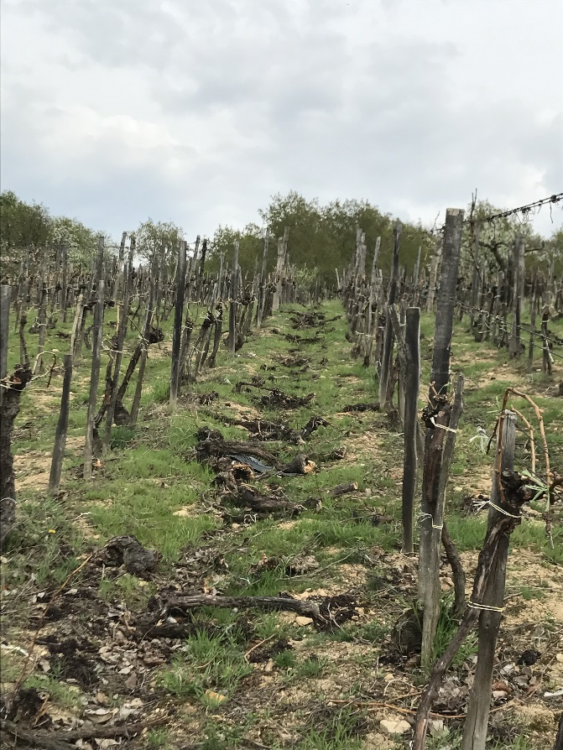
Destruction of inoculum sources
Inoculum found on diseased and dead plants
Pruning debris, symptomatic and dead vines = potential source of new infections
Get rid of all sources as quickly as possible
Pruning woods =crushed and buried in the soil, burned, crushed and compacted (40 to 50 °C for 6 months) or removed
Export dead wood from the plot ➔ dead wood represents an inoculum source for GTDs !

Slide 14















Trunk renewal
Cut the trunk above the rootstock and below necrosis
Produce sucker to obtain a new trunk
Simple technique
Good results with vigorous varieties
Effective in controlling Eutypa dieback and useful for Esca and BDA (but not curative, symptoms can reapers few years later)
Possible to anticipate the trunk renewal several years in advance

Slide 15
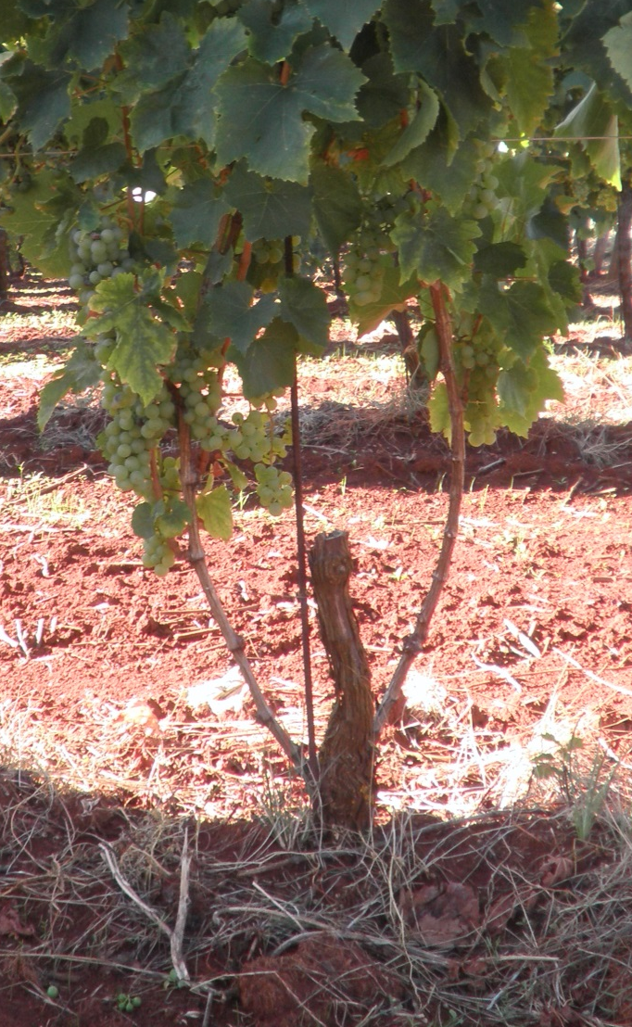
Trunk renewal
If possible protect the wounds with mastic
Estimated cost between 225 and 275 €/ ha for a plot planted at 4500 vines/ha with a proportion of 250 vines.

Slide 16
Re-grafting
Consists in grafting again a diseased vine starting from its healthy rootstock.
Slotted grafting is the most appropriate method
Carried out in spring during dry periods and when sap is getting up by service provision or by the winegrower himself
Cut the vine and verify that the cut’s location is healthy
Production: the year after a half-harvest then return to normal
Root system and age preserved
Complex technique (reach up to 80 - 90%)
Cost of the service : from 1.35 to 2.05 € HT/vine
3 months full-time to sustain grafted-vines for 4500 vines

Slide 17
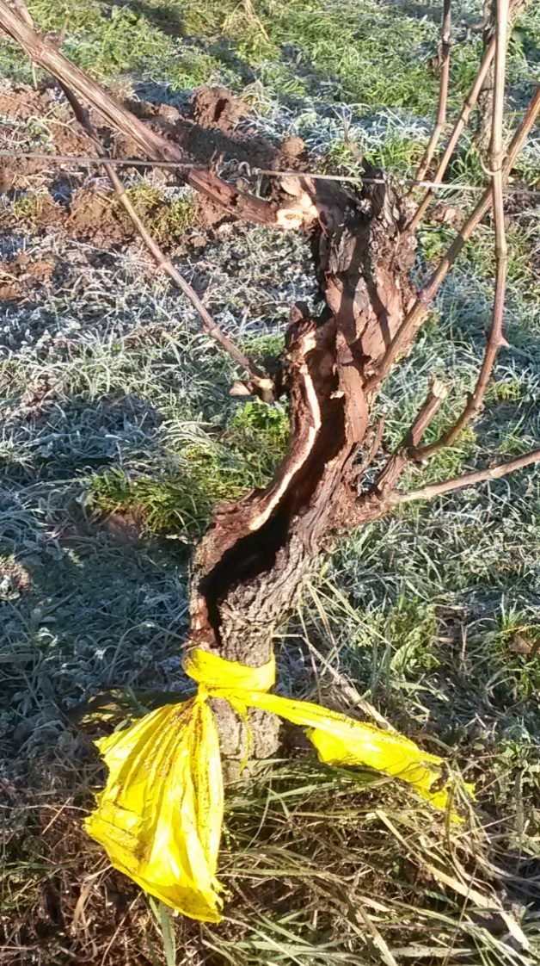
Trunk cleaning
Cleaning surgery to limit Esca and BDA
Harvest of the year preserved if done early
To clean, locate the pieces of rotten and spongy wood
Remove them from the trunk
Preserve healthy wood and sap flux
5 minutes to cure/vine
Need to be extended

Slide 18
Use of phytosanitary
Prohibition of sodium arsenite and Escudo®
No fungicide allowed against GTDs
Foliar application : calcium chloride, magnesium nitrate and fucal algae extract
  Natural defectives : Trichoderma or fertilizers
Preventive products :
  tebuconazol + synthetic resins or Esquive® WP
  Folicur (tebuconazole)
  Shirlan (fluazinam)
  Cabrio (pyraclostrobin)
  Bion (acibenzolar-S-methyl) + Cuprocol (Cu oxiclorure)
  Bion + Score (difeconazole)

Slide 19
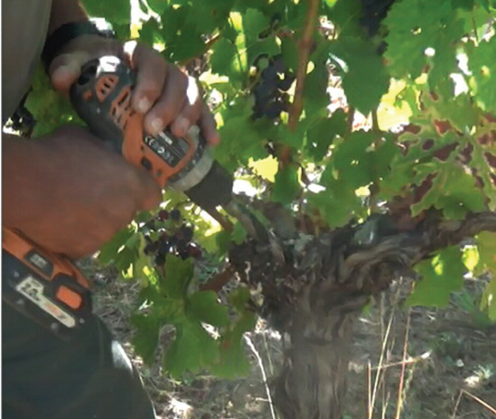
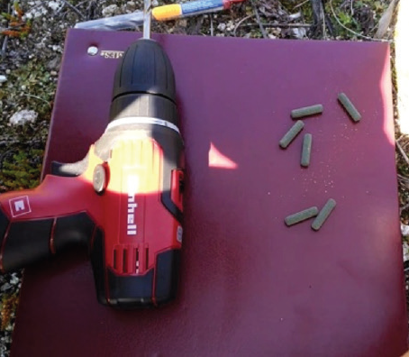
New methods
NOT SCIENTIFICALLY APPROUVED
Copper nanoparticles
Copper nails
H₂O₂ injecting
Soaking in fungicides

Slide 20
Conclusion
Symptoms influenced by many factors
Indigenous microflora can interact with GTDs fungi
Growing conditions ,pruning system and wound protection can be relevant factors
Better knowledge would help to better understand the action mode of these diseases
Many tested methods but need to be scientifically validated
Single control method is not effective, limitation of GTDs by a combination of preventive methods

